Slide 1

PROTOTYPE
DATA ANALYSIS ON NEXT LEVEL PRAYERS

Slide 2
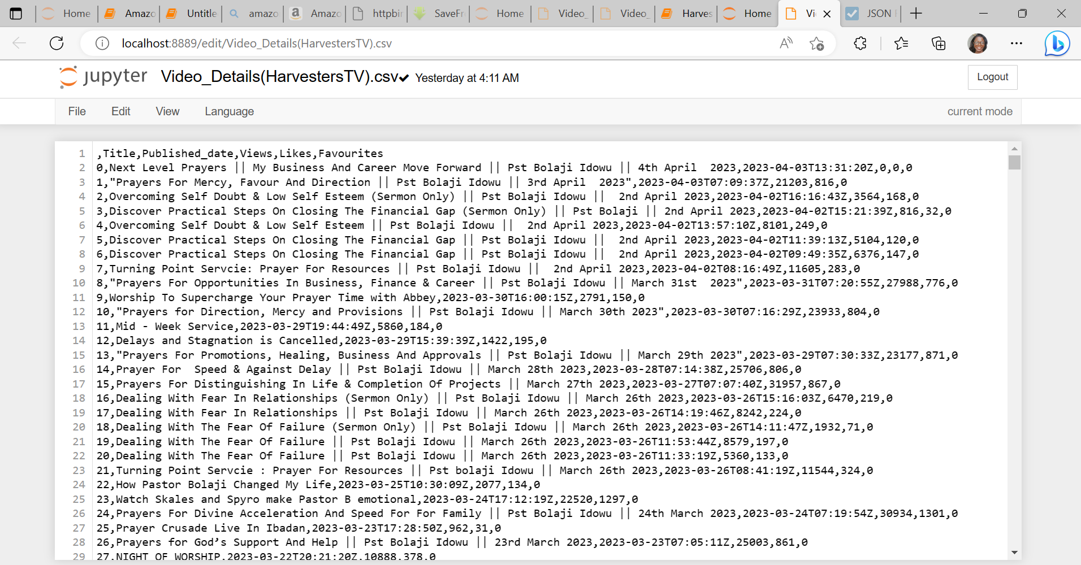
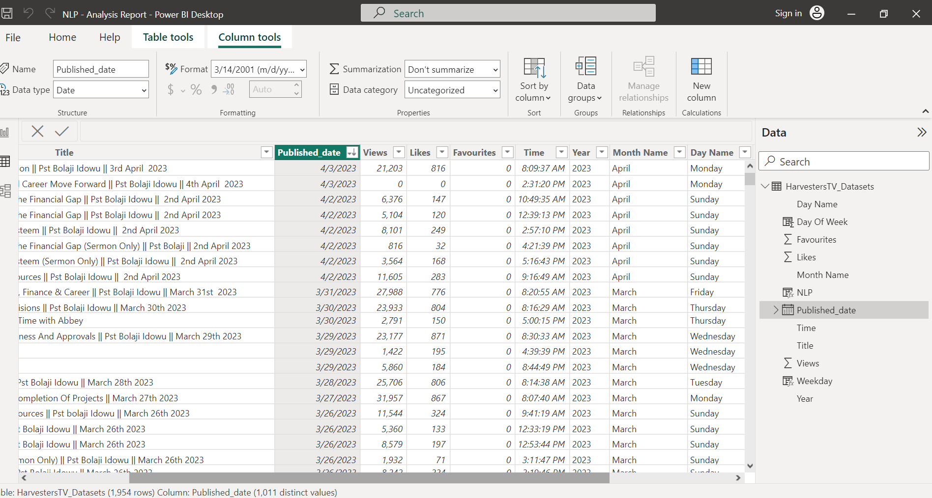
DATA EXTRACTION & TRANSFORMATION
fig 1.
Extracted Data
fig 2.
Transformed Data

Slide 3
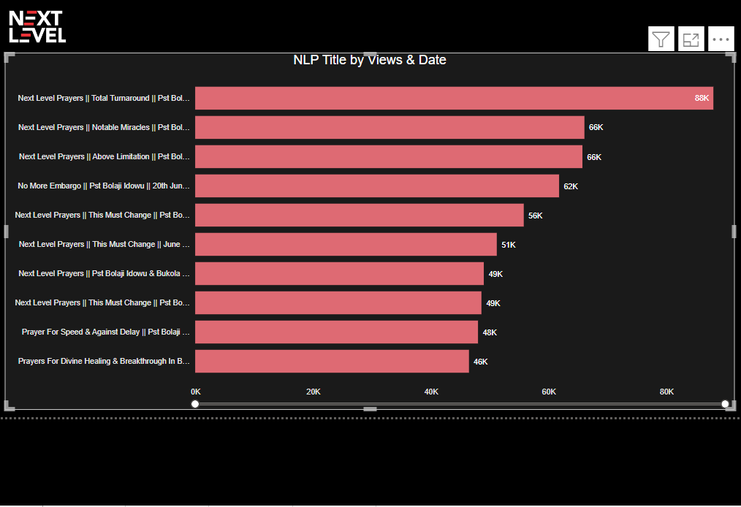
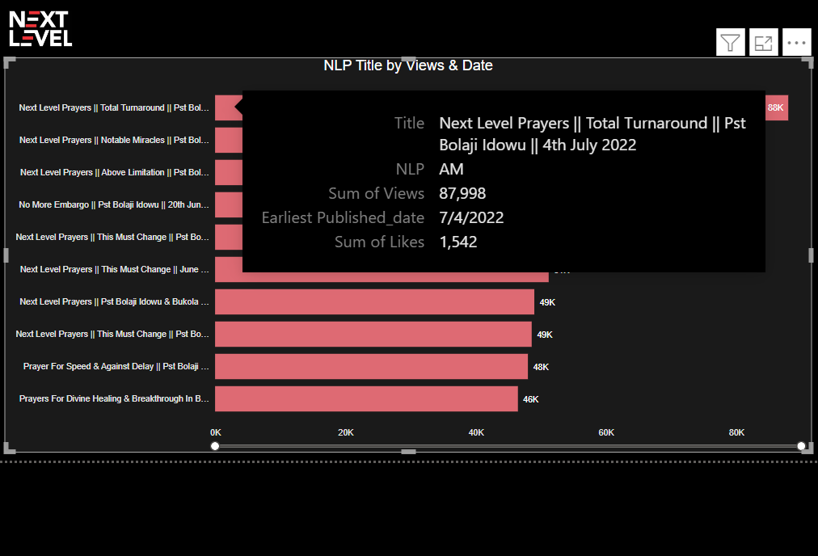
ANALYSIS BY VIEWS
fig 3.
Analysis.
Fig 3 shows the top 10 NLP video with the highest number of views.
Fig 4 is showing the title of the NLP video with the highest views, the total number of views, likes and the date the video was published.
Insights.
fig 4.
Based on the analysis, it is clear that this is most watched video but not most liked.

Slide 4
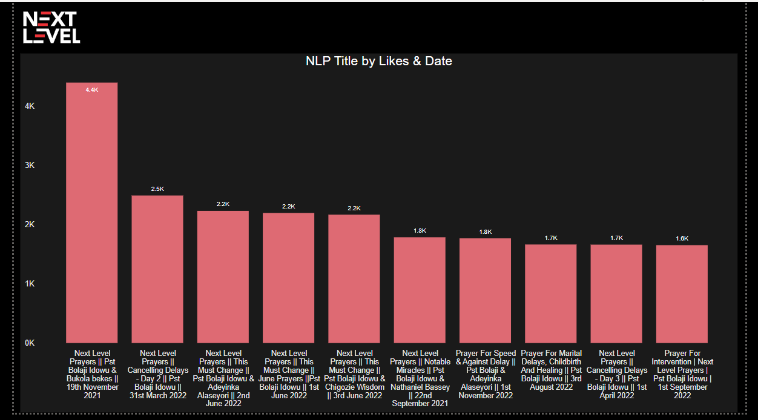
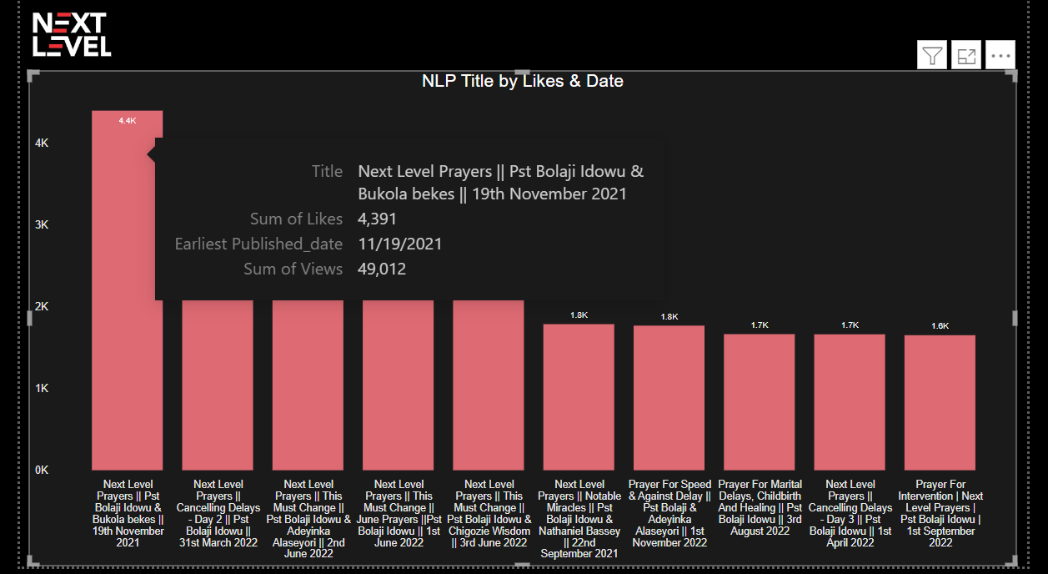
ANALYSIS BY LIKES
fig 5.
Analysis.
Fig 5 shows the top 10 NLP video by it’s views.
Fig 6 is showing the title of the NLP video with the highest likes, the total number of views, and the date the video was published.
Insights.
fig 6.
As seen in fig 6, the highest liked video is this which is over 200% higher than the likes of the most viewed video in fig 4. above.
It is also the 7th highest viewed video.

Slide 5
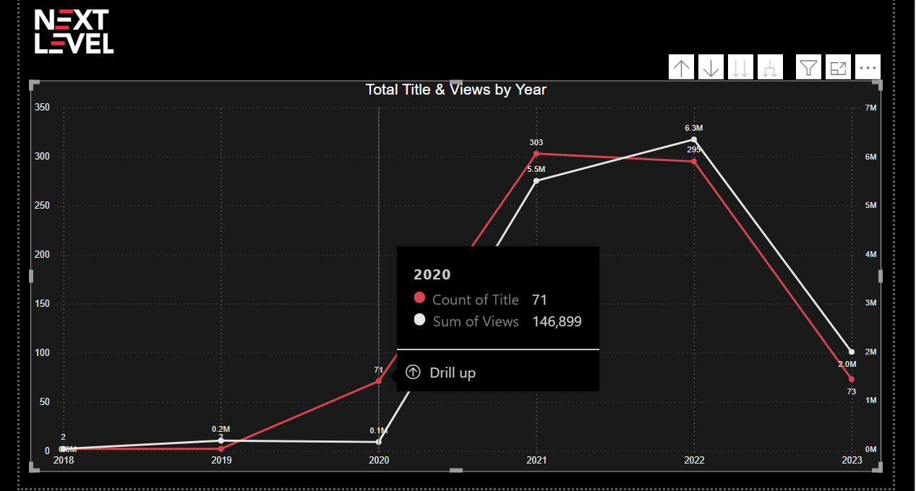
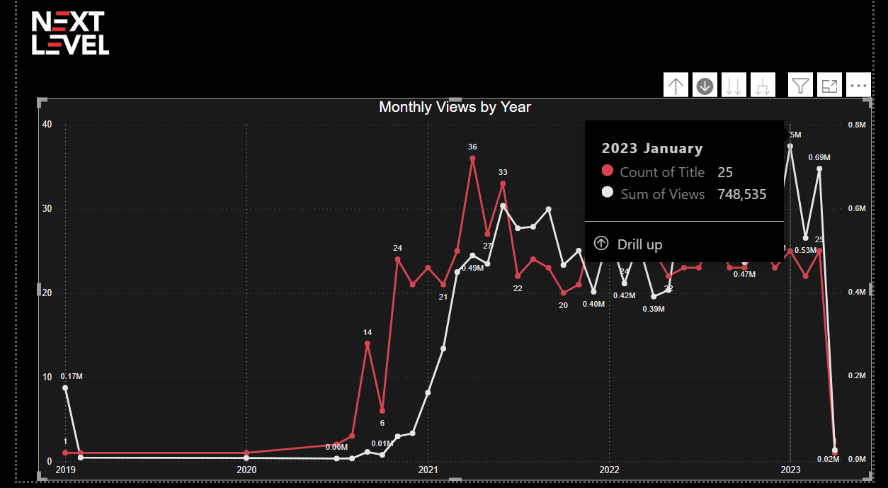
ANALYSIS BY DATE
fig 7.
Total Views by Year
fig 8.
Total Views by Month

Slide 6
SUMMARY
Above is an analytical report built using Power BI, with data scrapped from the web “HarvestersTV YouTube channel” using Googleapi_key and Python.
The analytical report above breaks down the performance of NLP based on it’s highest views, likes, and date.
The analytical report in fig 6. which shows the highest-liked video and also the 7th highest viewed video with over 200% higher than the likes of the highest viewed video in fig 4. reflects that viewers really liked the sermon with Bukola Bekes. Having a strong liked rate is a good step in generating a very effective marketing channel. In this regard, the reach out seems promising.
Next in the pipeline is the conversion rate, 50% of the top 10 most viewed and liked videos had an external guest which gives the description that viewers look out for popular external party like “Nathaniel Bassey, Bukola Bekes, Adeyinka Alaseyori and the likes…..
Therefore, I’d suggest we have more people like this at the NLP which will most definitely increase traffic.

Slide 7
SUMMARY contd.
Where it all falters however is in the final, and most important metric: Time. We have less views on Mondays which simply means that majority of viewers are working and would most definitely be more concerned on how to get to work on a Monday morning rather than attend NLP.
There are few possible solutions:
Switch up the viewers, by having important guest that viewers wouldn’t want to miss.
Have more prophetic topics to command the week.
Finally, the date analytics which shows the months and years by total videos and views. This particular chart is important to figure out trends in data, fig 7. shows that year 2022 had the highest viewed video of 6.3M total views with an average #500k views per month. This pattern persisted up until January 2023, when it rose to over #700k views, the largest views so far, In February there was a decrease which I believe might be due to short days.
Therefore, the data demonstrate that during the last 6 months, there was a good increase in views.

Slide 8
THANK YOU

